Slide 1

NACDEC – 4 Team Saphira
Faculty Guide : Prof. Dhwanil Shukla
Amal Sebastian
Goparaju Khushal
Rohit Tembhare
Ronit Shukla
Vishnu Sankar
Notes:
Hello everyone we are Team Saphira! Let's get started with the presentation.
Estimated Time – 10 seconds

Slide 2
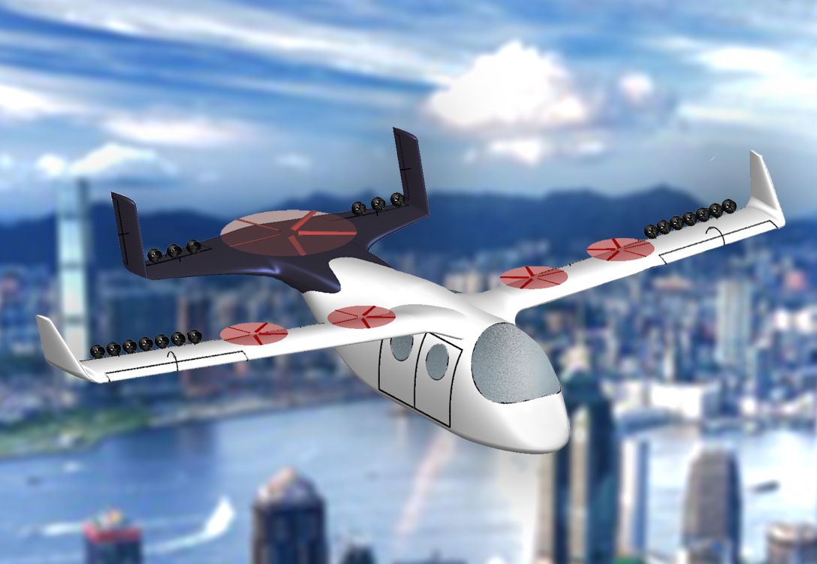
Final Design
RFP Requirements
Parameter​ | RFP requirement ​ | Estimated value​
Range​ | 500 km​ | 645 km (500 kg payload)​
Payload capacity​ | 500 kg​ | Upto 1000 kg *​
​Air Taxi mode | 4 Pax. And 0.5 m³ | ​4 Pax and 0.5 m³
Air Cargo Mode | 1.5 m³ hold | 1.5 m³
​Cruise and Maximum speed | ​200 and 250 kmph TAS | ​200 and 262.8 kmph
Powerplant | Green | Hydrogen Fuel Cells
Entry to market | By 2030 | Can be achieved by 2025 (HyPoint)
Notes:
We will begin with a quick look at the final design of our plane, see what are some of the core features are and how well we have been able to comply with the RFP. If you look to the left of your screen we see an image of the final design, some of the key things to note are that we have rotors built into the main wing and the tail (Our model shows them on top, but it is actually inside the wing) and we have EDFs placed along the trailing edge of both the wing and the tail. The rotors are meant to carry out the VTOL part of the mission and the EDFs are meant to be used for the cruising part. If we look at the RFP requirements v/s our estimates, we see our estimates suggest better performance than what was required to be designed in most aspects.
{45-50 seconds}

Slide 3
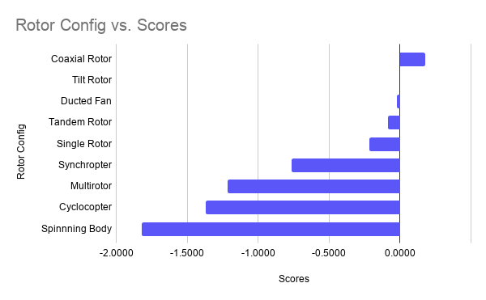
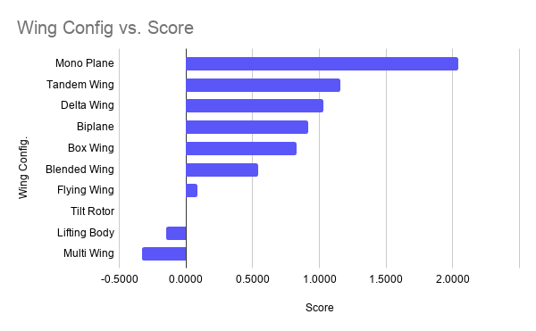
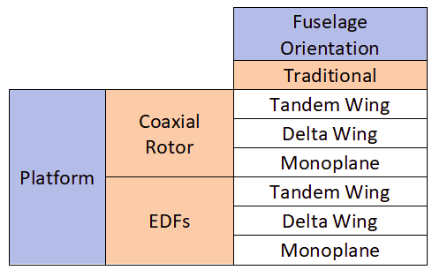
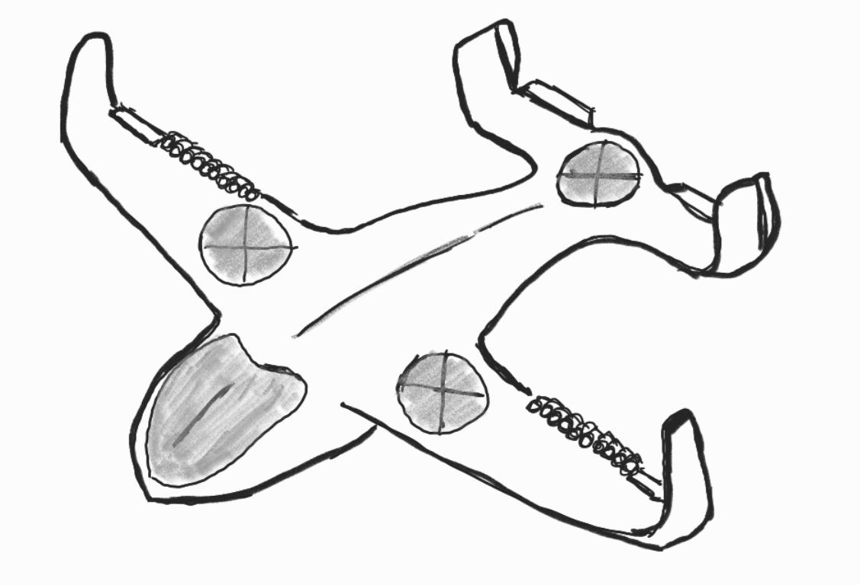
AHP tables
Pugh Matrix for Rotor Configuration
Pugh Matrix for Wing configuration
Range
Payload
Noise
Max. Speed
Safety
Stability
Empty weight fraction
Endurance
Cruise speed
Manufacturability
Maneuverability
Notes:
We saw that our design does seem to lie on the unconventional side of things, so we will give you a brief idea of how we went about selecting the configuration of our plane. We started off with the AHP method to determine which were the most important parameters for our mission from the list shown in the slides . We did this separately for both the passenger and cargo configurations of our mission. We then used the AHP computations as weight for Pugh matrices which were done for for various types of rotor and wing configurations, which you can find mentioned in the graphs. The Pugh matrix computations were also done for both cargo and passenger modes. After all the computations, the numbers suggested two possibilities for rotors – EDFs and coaxial rotors and 3 possible wing configurations – tandem, delta and monoplane. Weighing other factors based on our mission we finally decided to use EDFs for cruising and coaxial rotors for VTOL and use a monoplane configuration for the wing. On the bottom right you can see an image of the initial proposed design, which looks quite close to our final design.
{1 minute 5 seconds}

Slide 4
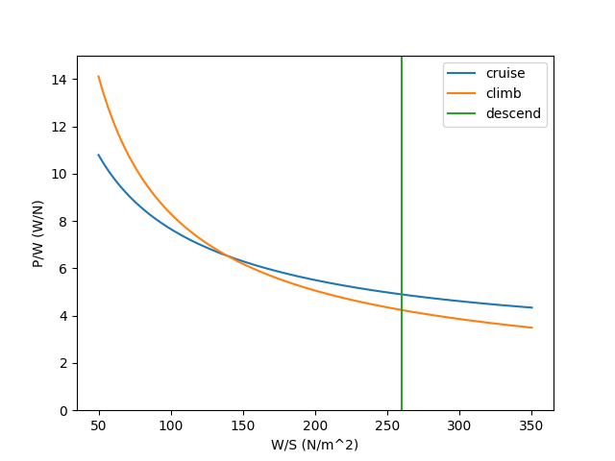
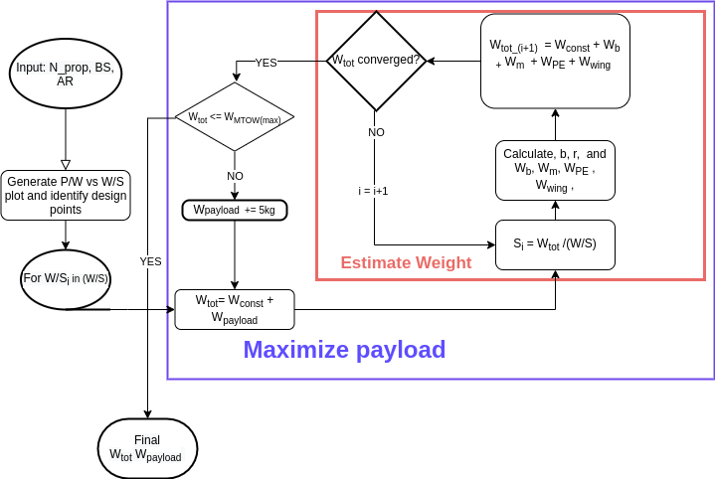
Sizing
Notes:
Details:(40 sec)
We started with a survey of a similar category of VTOL aircraft to get estimates of MTOW and bounds for parameters such as the number of propellers and aspect ratio. Then we implemented an algorithm based on work by Xiao et al. The algorithm first samples a design by choosing three parameters- number of propellers, aspect ratio, and the ratio of wingspan swept by the propellers.
Based on these parameters, we calculated the constraint curves in power-loading and wing-loading using equations based on the mission profile.
Then algorithm tries to maximize the payload for different possible wing areas. It involves inner iteration, which calculates MTOW for a given configuration, and an outer iteration to increase payload until the algorithm reaches the desired MTOW.

Slide 5
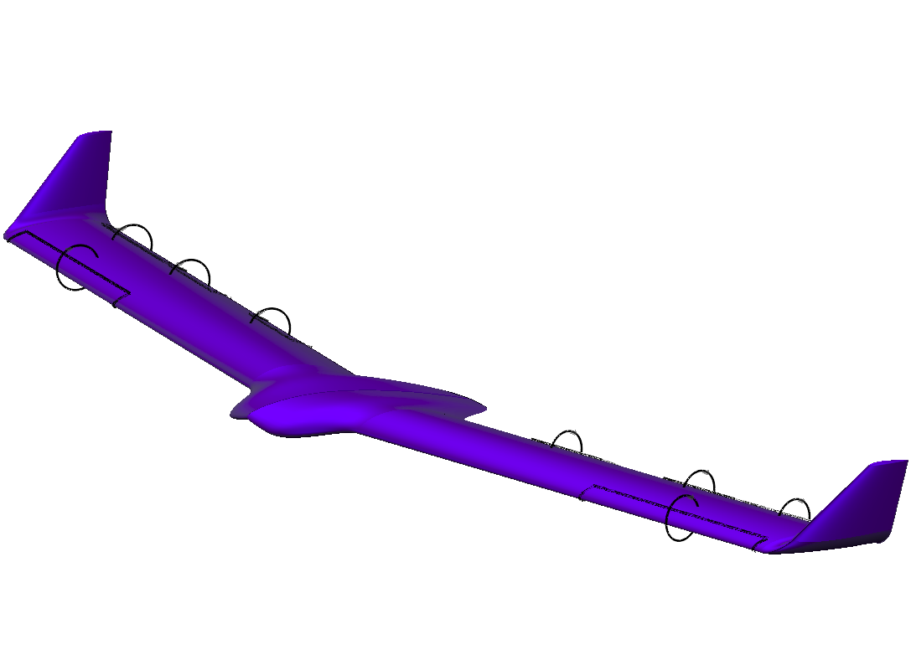
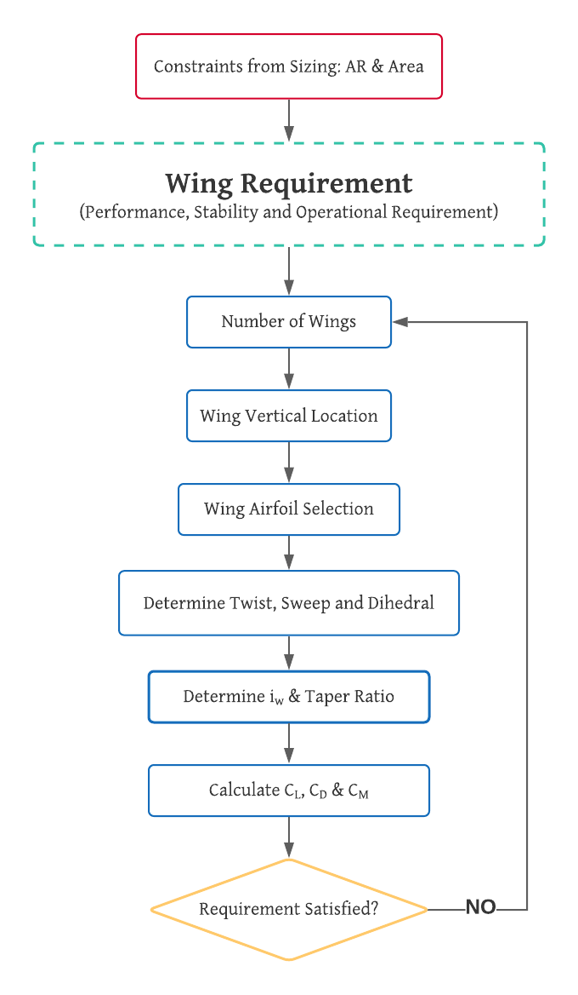
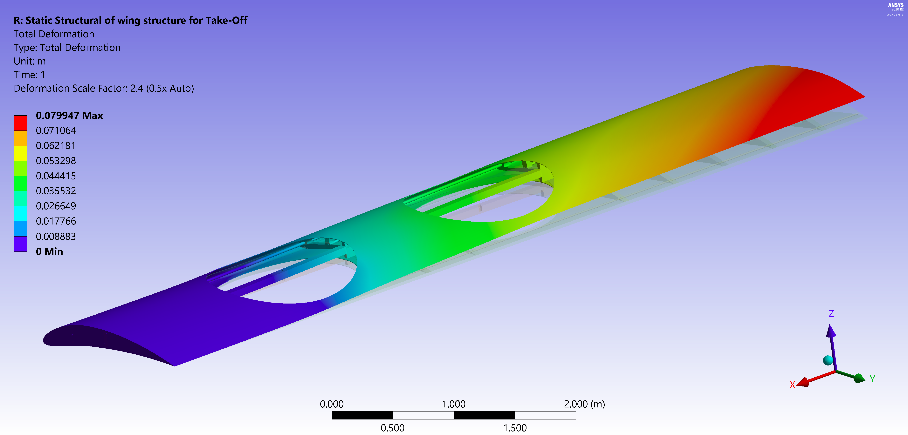
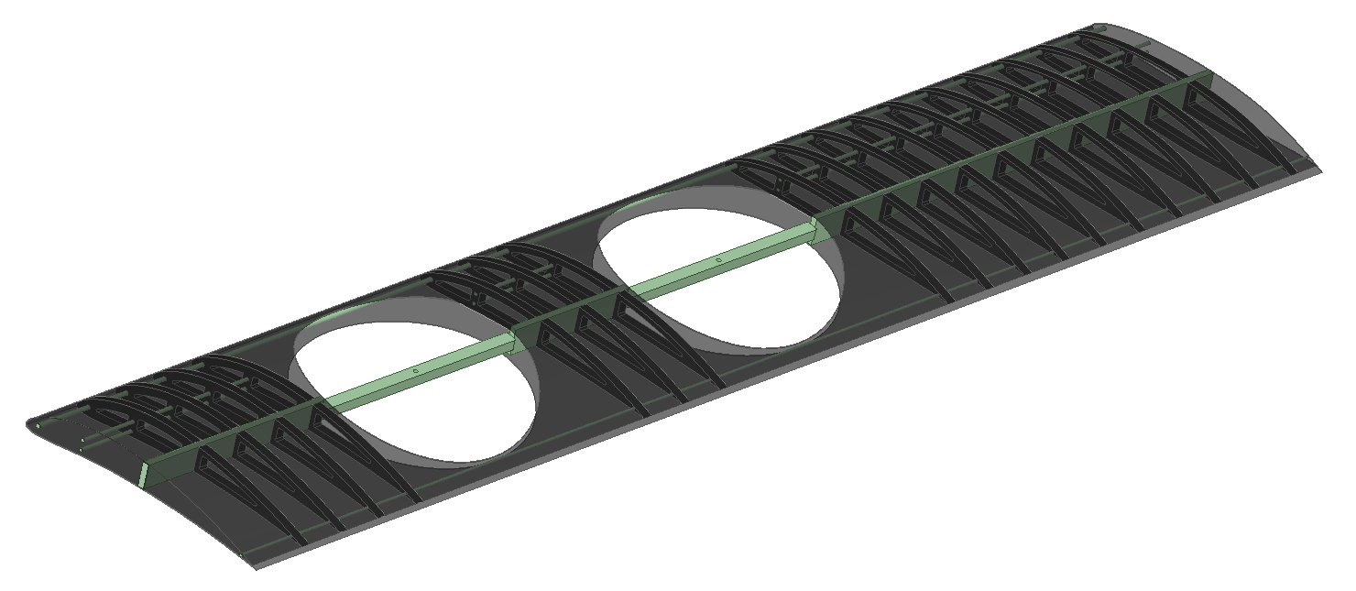
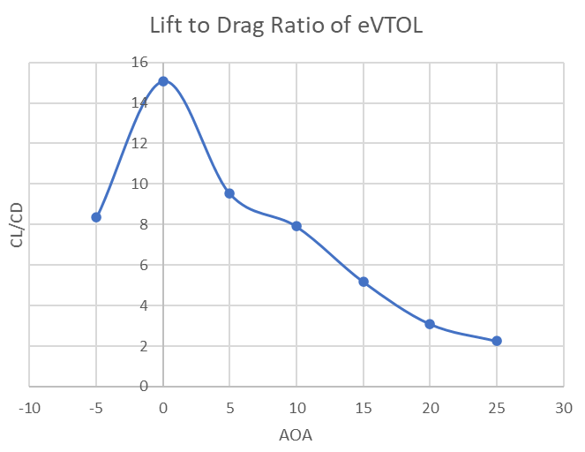
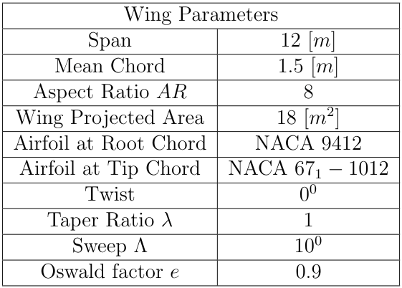
Wing Design
Notes:
Now we will discuss the philosophy of wing design. Using cruise lift conditions at 1 km altitude, we calculated the lift coefficient which was around 1.25. We then shortlisted high lift airfoils, made their wings and tested those wings using a simple lifting line theory to finalize the airfoil. The large space inbetween the wings are for the rotors to be placed and are covered by shutter mechanisms. Since the rotors had to be placed inside the wing, this was only achieved with a taper ratio of 1.
For getting to an initial estimate of the structural components of the wing, we started with the spar by considering it as the primary flexural load carrier. Then we used Beam Theory and performed a parametric study for different materials to find the mass, minimum thickness, tip deflection while ensuring no plastic deformation. Next for the axial loads arising in the wing, the effective column length of the stringer was decreased by placing ribs such that the buckling in the stringer and the skin can be avoided and the wing cross-section shape is retained.
(~90 seconds)

Slide 6
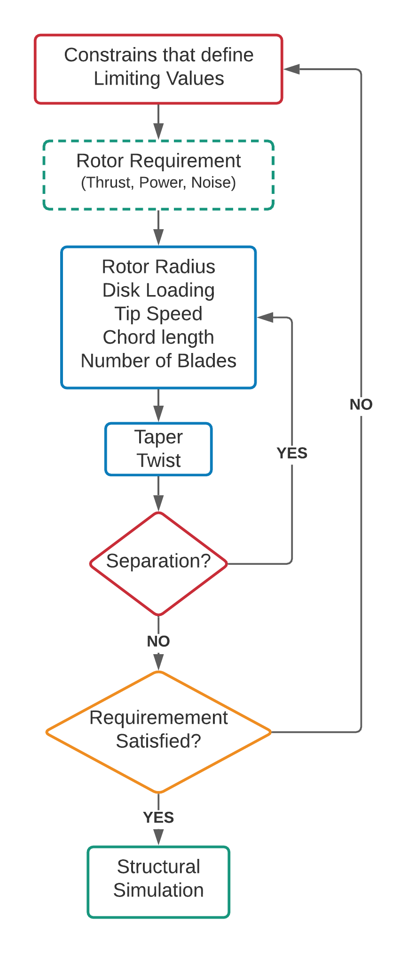
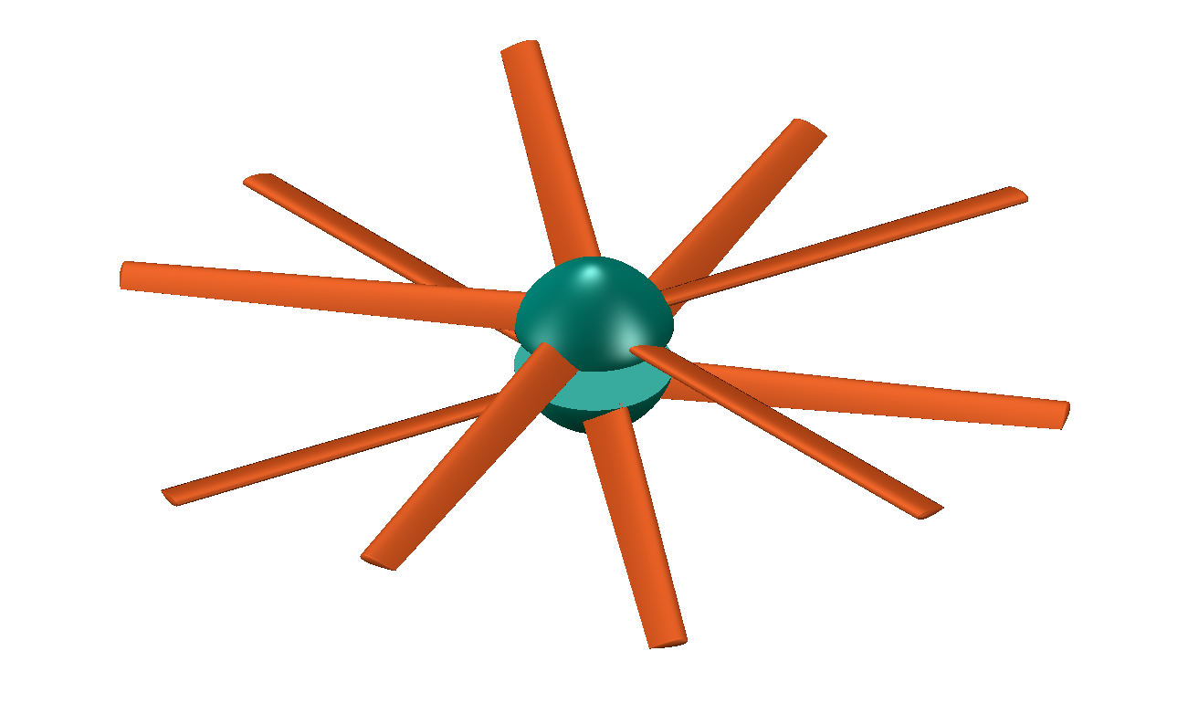
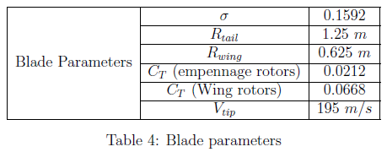
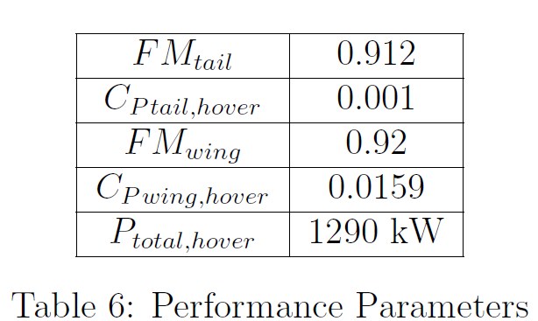
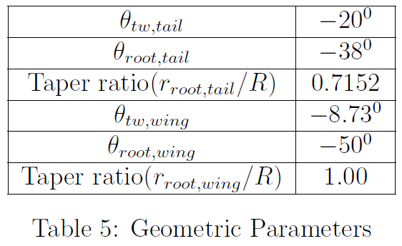
Rotor Design
Notes:
(50 sec) Moving on to the rotor design.
Using the data available for other rotorcraft systems used a curve fit approach to identify an approximate value for Disk loading. This was used to find the radius. We made an inhouse Python code using the Numerical Blade Element Momentum Theory to calculate the parameters shown in the table. The Python code was used to evaluate the parameters of a single rotor, and certain empirical values were used to extrapolate the results to a co-axial rotor system. Each coaxial set up has 10 blades in total and weighs about 40 kilo grams.

Slide 7
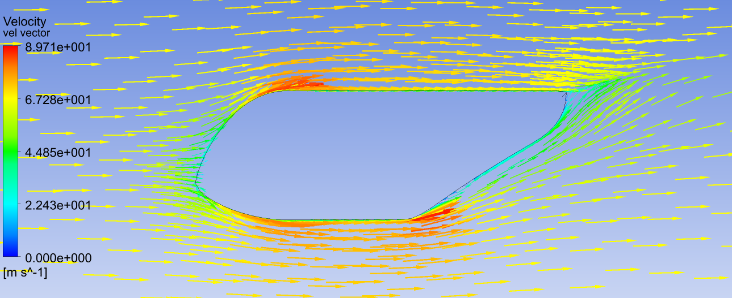
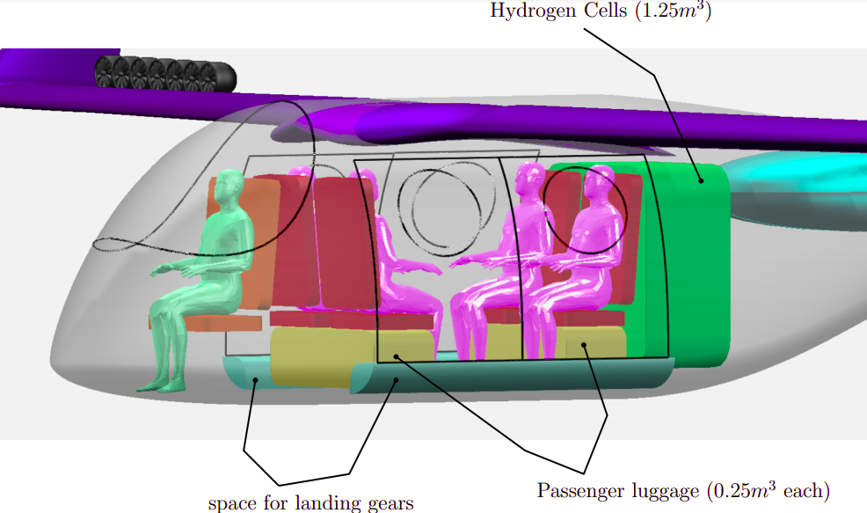
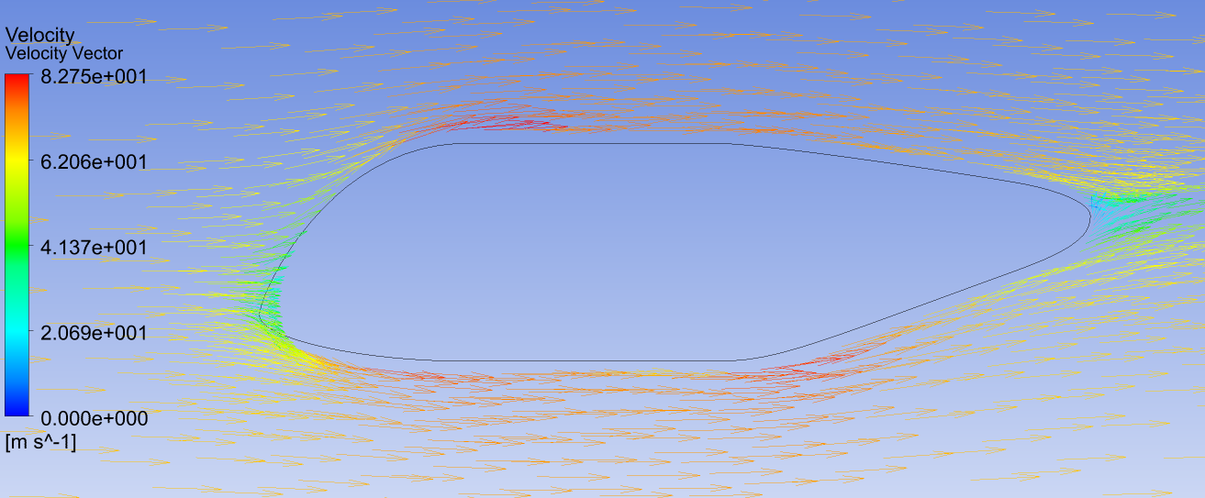
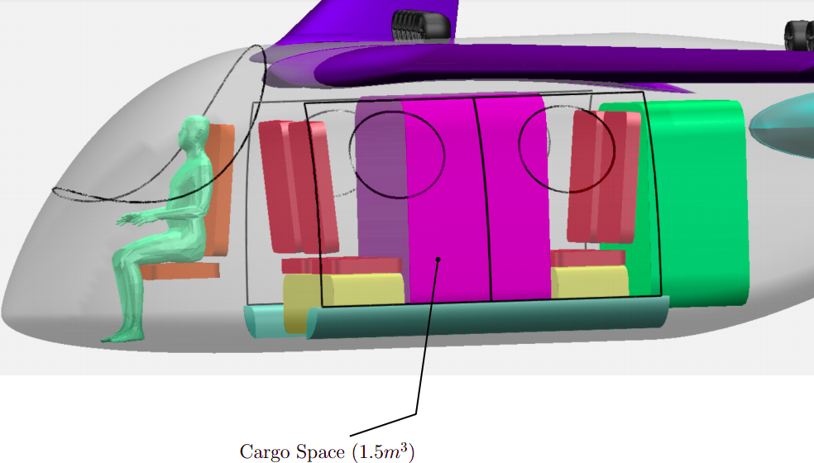
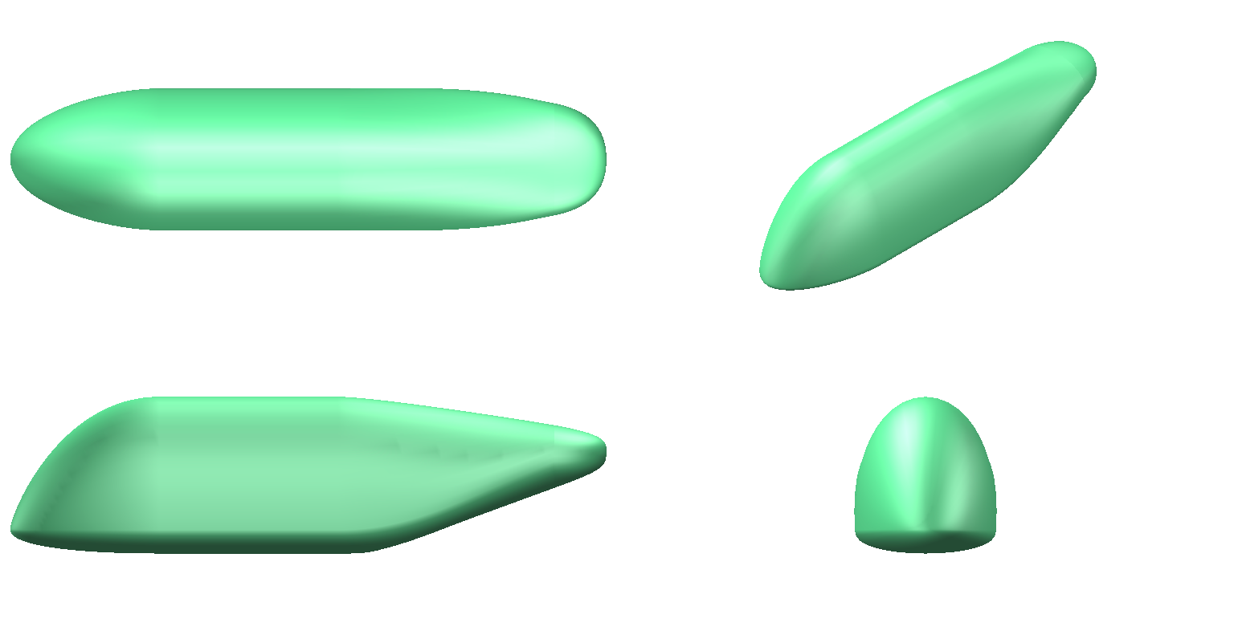
Fuselage Design and Seating
Notes:
Now let's look into the Fuselage Design and Seating
The fuselage is divided into 3 sections, cockpit at the front and cargo/passenger section in the middle and third section is used for the storage of batteries.
As you can see the top left image, Initial fuselage design was compact, but as the velocity contour shows, there is high separation at the back.
The bottom one is the optimized image, which has significantly less separation at the rear end.
There are two modes of functioning, the first one has 4 pax +0.5 meter cube cargo which are kept below the seats.
The second configuration is the 1.5 m^3 complete cargo mode, and it can easily be placed between the seats as shown in the bottom figure without removing any seats. The space for landing gears is also showed in the fuselage.

Slide 8
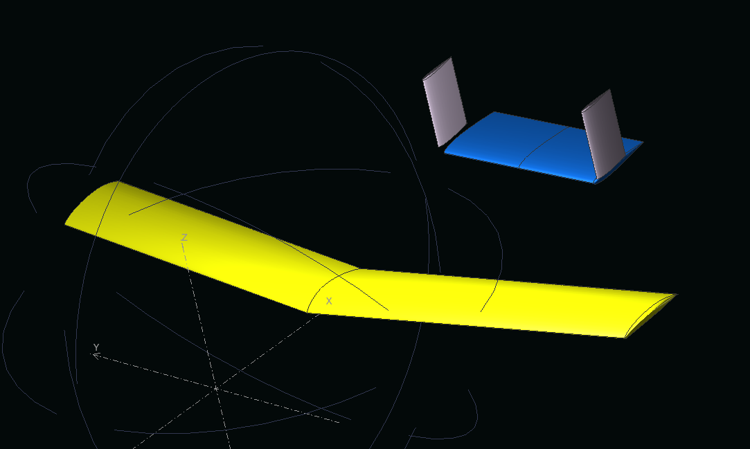
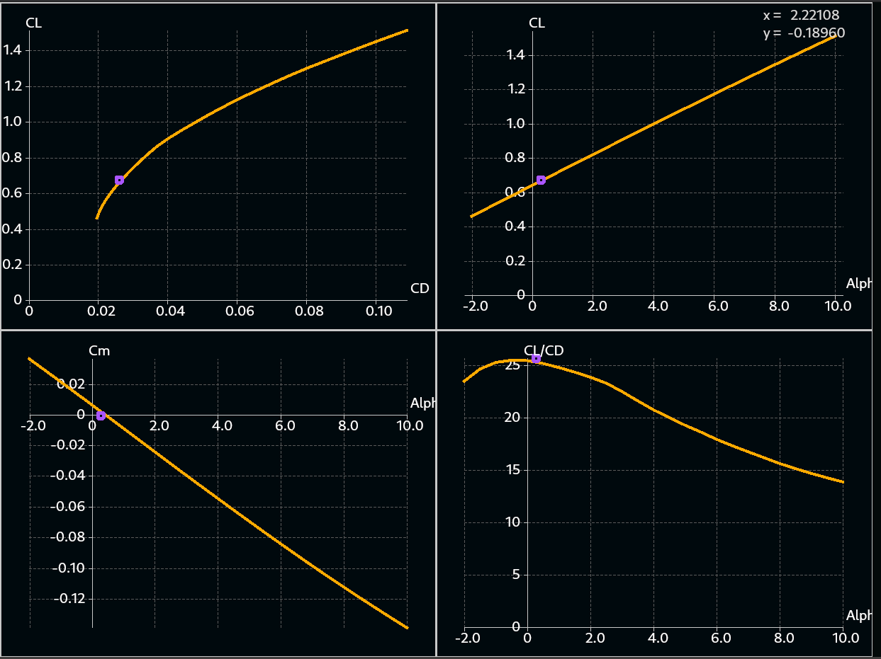
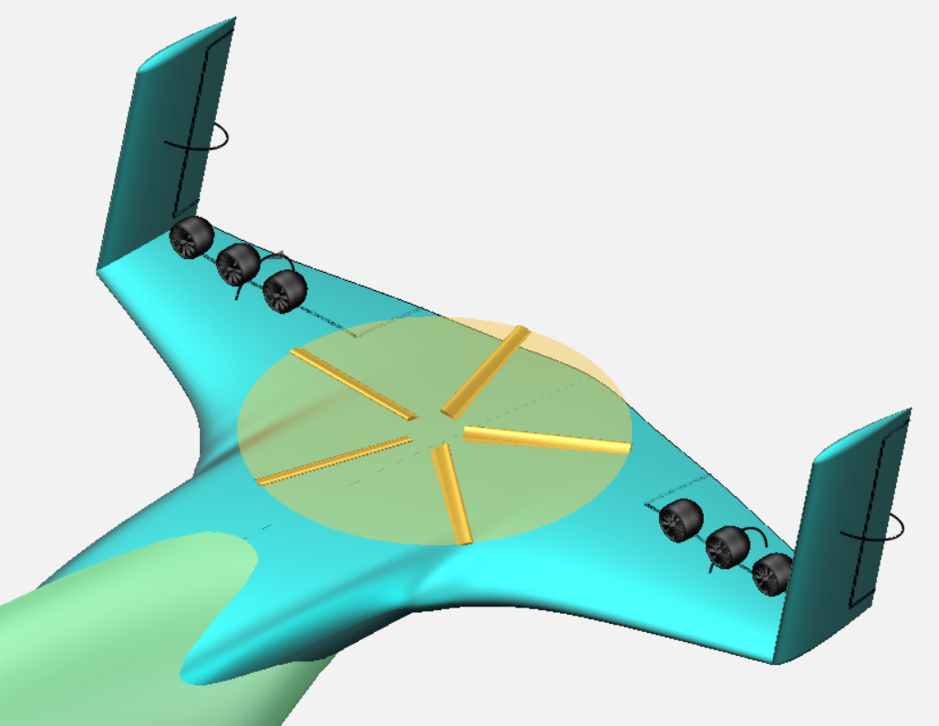
Stability
Notes:
(39 sec)
Now let's talk about how the aircraft performs as a whole starting with stability. To ensure the stability of the aircraft, stability analysis was performed on a simpler model of the aircraft using XFLR5. The tail was sized to have a trim condition near the aircraft's maximum aerodynamic efficiency. After confirming static stability, we performed dynamic stability analysis for lateral and longitudinal motions for different dynamic modes, including Phugoid and short period modes for the longitudinal motion and Roll damping, Dutch roll, and Spiral modes for the lateral motion. Our analysis suggests that the current configuration is stable.

Slide 9
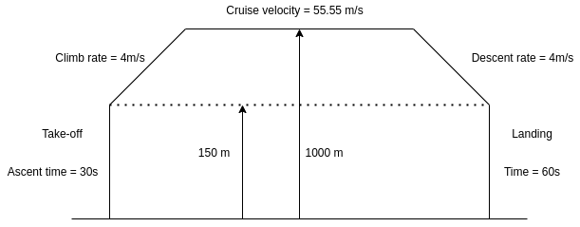
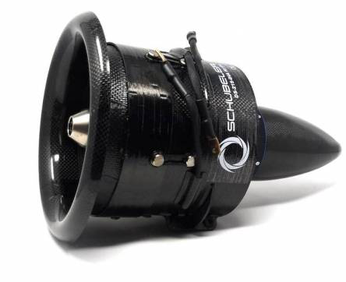
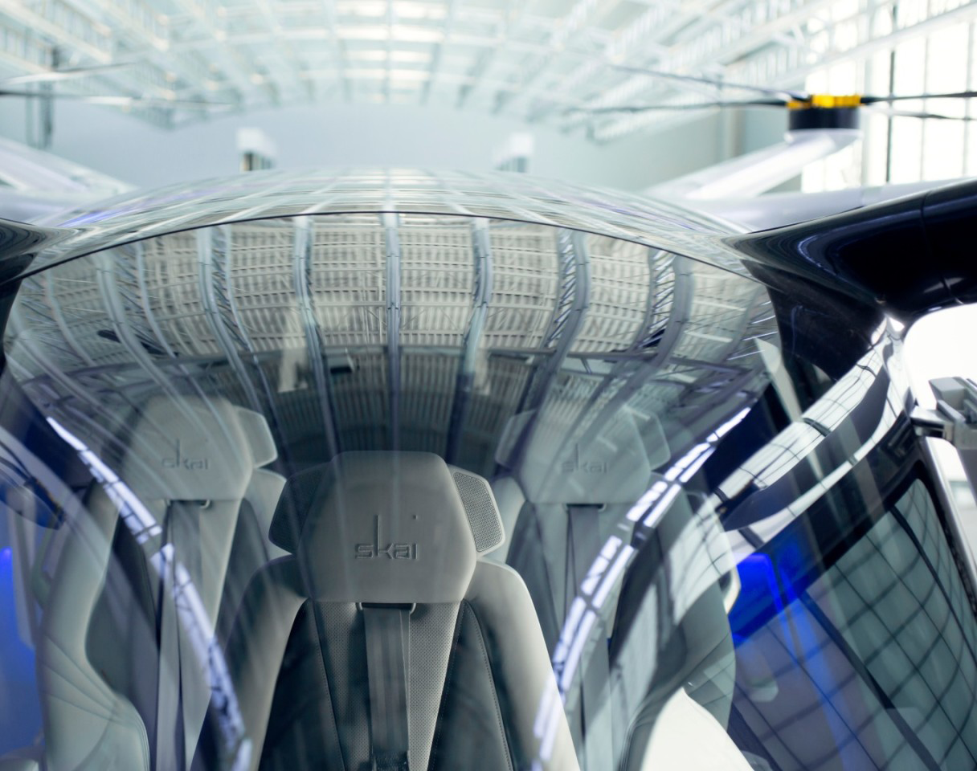
Mission Profile
Σ [P_{average of each stage} x T_{each} _{stage}]
1. Take Off --> Hover --> Cruise Flight Time = 4 mins
Average Power Required = 1400 kW
2. Cruise Flight
Flight Time = 3 hrs
Average Power Required = 180 kW
3. Cruise --> Hover --> Landing
Flight Time = 4 mins Average Power Required = 1400 kW
Total Energy Required ~ 732 kW-hr
HyPoint's Proposed Specific Energy = 960 W-hr/kg
Total Energy in the design (if linearized) = 1125 kW-hr
Total Energy after considering a 20% drop = 900kW-hr
Mission Profile
Schubeler 195 EDFs used for Forward Thrust
Prototype of HyPoint H2 Fuel Cells situated in Alakai Skai
Notes:
Let's now move on to the crucial aspect of mission profile. For our eVTOL, there are sections in the mission like take off, ascend, cruise, descend and the landing. Every part of the mission has different power requirements. The upper cap on total energy which was required roughly for the entire mission came out to be around 732kW-hr. After a thorough research, the green power source we decided to use is a variant of Hydrogen Turbo Air Cooled Fuel Cells, which is proposed by HyPoint Incorporation which intends to provide 960W-hr/kg of specific energy. Which is way better than the Li-Ion options we have as of today. HyPoint is aiming to release it by 2023 for an multirotor VTOL named Alakai Skai. We extrapolated the specifications of the prototype mentioned in their white paper for our VTOL and it gave us a staggering total energy of 1125 kW-hr. But as it was a linear extrapolation, for reality checks, we only considered 80% of the total, I.e, 900 kW-hr. And as the numbers suggest, we would still have 168kW-hr of backup energy left in the system after the inter-city travel of approx 600kms. And hence we can say HyPoint Hydrogen fuel cells is a reliable source of energy for this vehicle. Estimated Time : 1:20

Slide 10
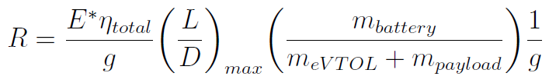
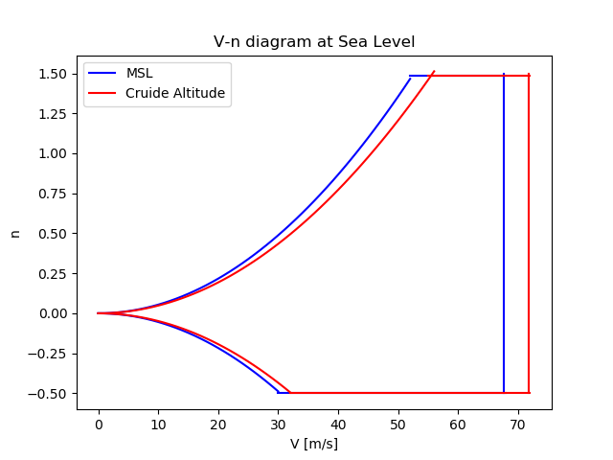
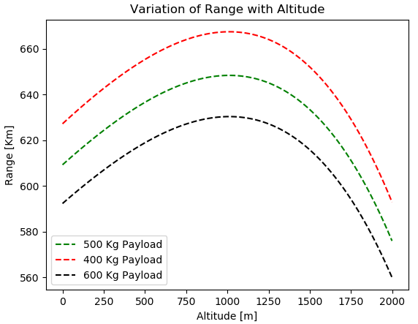
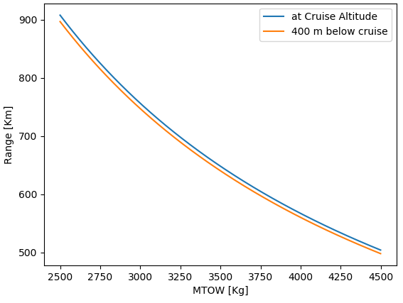
Performance
Variation of Range with MTOW
Notes:
(65 sec)
Moving on to the performance aspect, the term L/D is controlled entirely by the design process. We can observe from the first graph that a 100 kg change in payload affects the range only by 20 kms. And the range is maximum at the desired altitude of 1 km for cruise. But even at an off design condition of 1.4 km or 600 m altitude, the payload reduces only by 35 kgs. We can also see that the MTOW can be increased by 1000+ kgs for a range of 500 km. Although the limit of L/D depends on the class of aircraft, we have designed our eVTOL to work in most of the off-design conditions.

Slide 11
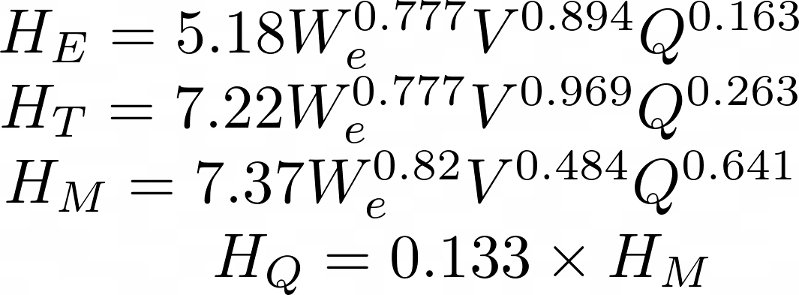
Cost
 | Man Hours per Unit [hr] | Rate for 1 unit [Rs/hr] | Total Cost per unit [Rs]
Engineering | 208 | 8556 | 17,79,648
Tooling | 265 | 8780 | 23,26,700
Manufacturing | 3883 | 8035 | 3,11,99,905
Quality Control | 295 | 7292 | 21,51,140
Materials | 154952 | / | 1,54,952
Total (After adjusting for composites & inflation) |  |  | 7,04,10,310
Total operating cost: Rs.25,42,590
Notes:
We finally take a look at the cost of developing such an airplane and operating it. We were able to come up with some cost estimations using information from a few research papers that proposed empirical data fits. These data fits were based on the principles of DAPCA-IV method.
The estimated cost for building our plane is around 7 crore rupees per unit and the operating cost is around 25 lakh rupees per year.
{17-18 seconds}

Slide 12
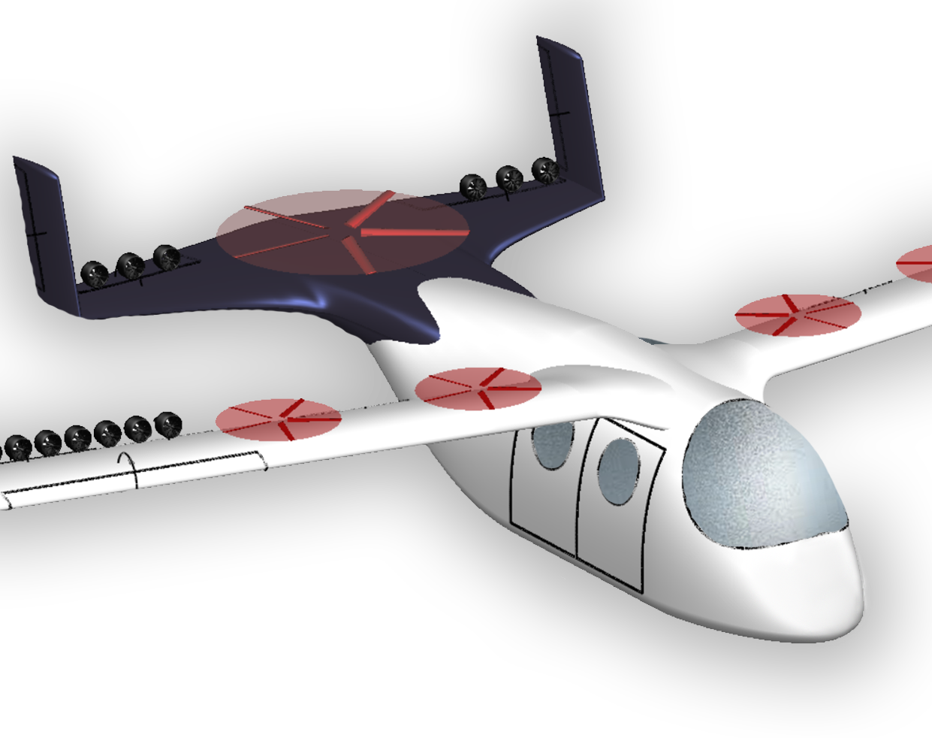
Thank You
A big thank you to all the professors, organizers for this competition and making this great learning experience possible!
~ Team Saphira
We are now open for questions!
Notes:
So yeah, that was everything about the design of our eVTOL and we would like to thank all the organizers for conducting this competition and allowing us to have such a great learning experience. And now, we are open to questions, thank you!

